Slide 1
E-Commerce
Lecture – 01
Lecture By:
Shakir Rasheed Khan Khattak

Slide 2
~ You are a marvel ~
Each second we live is a new and unique moment of the universe, a moment that will never be again… And what do we teach our children?
We teach them that two and two make four, and that Islamabad is the capital of Pakistan. When will we also teach them what they are? We should say to each of them:
Do you know what you are? You are a marvel (Genius). You are unique. In all the years that have passed, there has never been another child like you. Your legs, your arms, your clever fingers, the way you move.
You may become a Shakespeare, a Einstein, a Newton. You have the capacity for anything. Yes, you are a marvel. And when you grow up, can you then harm another who is, like you, a marvel?
You must work – we must all work – to make the world worthy of its children.
Pablo Casals (1876-1973)
Lecture By:
Shakir Rasheed Khan Khattak

Slide 3
Today
Who I am?
SE-346 E-Commerce (and why)
Overview of the Course
Quick overview of E-Commerce and Why we study it.
Lecture By:
Shakir Rasheed Khan Khattak

Slide 4
Education: BS Software Engineering NUML-Islamabad, MS Software Engineering FAST-Islamabad.
Professional Experience: 5+ Years of IT industry experience.
Software Engineer @ International Islamic University, Islamabad.
Visiting Faculty Member @ International Islamic University, Islamabad.
Involved in industry-driven research and development projects.
Expertise: Requirement Engineering, Software Architecture, Software and Web Development, Software Testing, Model Driven Software Engineering, Model-Based Testing, Empirical Software Engineering.
Lecture By:
Shakir Rasheed Khan Khattak

Slide 5
Email is the best way to contact me
Please ask questions during class the lectures should be interactive
Lecture By:
Shakir Rasheed Khan Khattak

Slide 6
Objectives
Introduction to SE-346 E-Commerce
Course Objectives; Outline,; Text Books and Reference Books,.
Delivery of the course and grading policy.
E-Commerce today
E-Commerce and social networking.
E-Commerce trends, 2010-2011 and onwards.
Define E-Commerce and describe how it differs from E-Business.

Slide 7
Policy: Delivery, Evaluation & Grading:
Delivery :
The course will be imparted through two tracks Track-1 (T1) comprising theoretical components of the course and Track-2 (T2) covering practical expects.
T2 will further be covered through Lab exercises and assignments.
Note: The students are directed to keep the pace with both the tracks. The assessment will be based upon T1 as well as T2.

Slide 8


Course Text Book Information
Text Book:
E-Commerce: Business Technology and Society Kenneth c. Laudon, Caral G. Traver 7th edition
ISBN-10: 0273-75084-4
ISBN-13: 978-0-273-75084-0
Edition: 7
Pub. Date: 2011
Publisher: Prentice Hall
E-Commerce: Kenneth c. Laudon, Caral G. Traver 6th edition Business Technology and Society
ISBN:0136100570
ISBN-13:9780136100577
Edition:6
Pub. Date: November 2009
Publisher: Prentice Hall
Note: The older editions along with lecture material will also be sufficient for this course

Slide 9
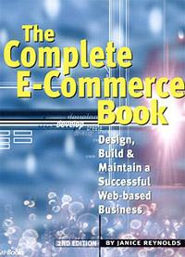
Reference Text Book Information
Reference Book:
The Complete E- Commerce Book Design, Build, & maintain a successful Web Based Business. REYNOLDS 2nd Edition
Also follow the references provided in the lectures and E-Commerce articles published.

Slide 10
Grading Policy
Assessment | Method
Assignments | 5
Quizzes | 5
Mid Term | 20
Final | 60
Project Presentation | 10

Slide 11
General Policies
Attendance will be taken every class and will be reported.
It is important that any work submitted is your own. Plagiarism and/or collusion will result in a possible disciplinary action.
Any late submissions will be taken with penalty.

Slide 12
Course Objectives
To understand the role of ecommerce in world economy.
Introduction & clear understanding of all types of e-commerce, associated technologies & their integration & effective interaction among these technologies.
Design & implementation of e-commerce applications and associated hardware, network & security infrastructure. Thorough understanding of the payment systems & methods.
Business, financial, marketing & behavioral model for ecommerce business.
Marketing & social impacts of ecommerce.
To gain a practical experience in some of the ecommerce techniques.

Slide 13
Facebook: The New Face of E-Commerce?
The Facebook is considered to be a new face for the E-Commerce as there are number of applications available for the users that enable them to interact through the online channels and buy various new products.
Do you use Facebook?
sure most of you do!!
Why?
Facebook today (2 February, 2023)) announced that it has passed the 2 billion user milestone. This makes Facebook the first social network to reach the 10-figure mark; one out of every seven individuals on the planet now use the service.

Slide 14
Facebook: The New Face of E-Commerce?
Have you purchased anything based on an advertisement at internet?
sure most of you did !!
Why?
“Big Data in Today’s Business and Technology Environment”
In 2022, the world would produce and consume 94 zettabytes data exist in the digital universe today. That is almost unimaginable data, which will only compound with the rise of the number of Internet of Things connected devices.
IDC Estimates that by 2020,business transactions on the internet- business-to-business (B2B) and business-to-consumer (B2C) – will reach 450 billion per day.
Facebook stores, accesses, and analyzes 30+ Petabytes of user generated data.
More than 5 billion people are calling, texting, tweeting and browsing on mobile phones worldwide.

Slide 15
Facebook: The New Face of E-Commerce?
Are you concerned about the privacy of the information you have posted on Facebook?
sure most of you are least bothered !!
Why?
Default Old policy of Facebook:
“ Only your friends will know about your face book profile”
New Default Policy of Facebook:
“ no privacy”

Slide 16
E-commerce Trends 2010-2011 and onwards: Business, Technology and Society
Business:
New “social e-commerce” platform is emerging based upon networks and support by advertising.
Social and mobile advertising platforms show strong growth.
Online business continues to strengthen profitability by referring business model and relying the capabilities of internet.
Retail e-commerce resumes double digit growth 12.5% annually 6 times faster than traditional retail.
Twitter continues to grow
The bandwidth of internet grows especially for entertainment with the result there is explosive growth in online video viewing.
Small business and entrepreneurs continue to flood into e-commerce marketplace, utilizing infrastructure created by industrial giants such as Apple, Facebook, Google, Amazon, eBay.

Slide 17
E-commerce Trends 2010-2011 and onwards:
Technology
Wireless Internet connections (Wi-Fi, Wi-Max, and 3G telephone) grow rapidly.
A mobile computing and communications platform based on iPhone, BlackBerries, and other smartphones, netbooks, computers and iPad becomes a reality and begins to challenge PC.
Over million Apps (October 2013) in Apple’s App Store, a new model of delivering services and software.
Bandwidth prices fall as telecommunications companies expand their capacities with new technologies.
Computing and networking component prices continue to fall.
Cloud computing and web services expand B2B opportunities and significantly reduce the cost of Infrastructure needed for e-commerce.
Real time advertising becomes a reality as firms gain in computing power and database speed.
The global population using the internet continues to expand.

Slide 18
E-commerce Trends 2010-2011 and onwards:
Society
Consumer and user generated contents at Social networks, Tweets, Blogs, wikis and virtual lives keep growing providing self publishing forums.
Newspapers and other traditional media adopt online, interactive models.
Social networks encourage self disclosures while threating privacy.
Traditional media continue to loose subscribers as online interactive models gaining popularities.
Copyrights conflicts are slowly being settling down as an informal understanding between internet users and copyright owners is being developed.
Explosive growth in the use of entertainment media continues.
Participation of adults in social networks such as Facebook is increasing.
Internet security worsens due to malware spams and identify theft occurrences.

Slide 19
The First 30 Seconds
First ten years of e-commerce represents just the beginning—also called the first thirty seconds of the e-commerce revolution.
Technologies continue to evolve at exponential rates
Disruptive/Disturbing business change
New opportunities
The twenty-first century will be the age of a digitally enabled social and commercial life, the outlines of which we can barely perceive at this time.
The next five years hold out extraordinary opportunities as well as risks for new and traditional business as it offers the possibility of extraordinary gains in social wealth as the digital revolution is taking place.

Slide 20
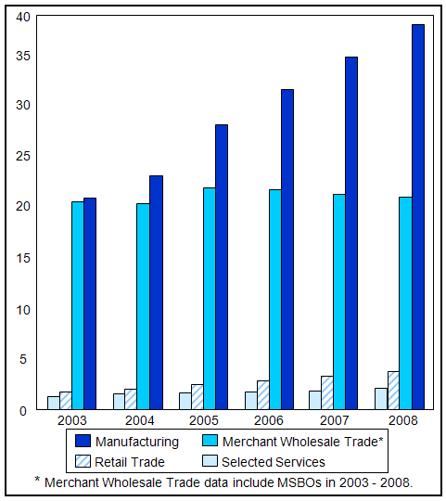
US Census Bureau 2008 e-Store Report
Retail E-Commerce (Non-Travel) Growth Rates Excludes Auctions, Autos and Large Corporate Purchases Total U.S. – Home/Work/University Locations Source: comScore, Inc.
Quarter | E-Commerce Spending ($ Millions) | Y/Y Percent Change
Q1 2007 | $27,970 | 17%
Q2 2007 | $27,176 | 23%
Q3 2007 | $28,441 | 23%
Q4 2007 | $39,132 | 19%
Q1 2008 | $31,178 | 11%
Q2 2008 | $30,581 | 13%
Q3 2008 | $30,274 | 6%
Q4 2008 | $38,071 | -3%
Q1 2009 | $31,031 | 0%
Q2 2009 | $30,169 | -1%
Q3 2009 | $29,552 | -2%
Q4 2009 | $39,045 | 3%

Slide 21
Thankyou

